Slide 1
Assessment of TDKENO/MOOSE Coupling for Simulating Transients with Thermal Feedback
Zander Mausolff*, Leslie Kerby**, Mark DeHart**, Sedat Goluoglu*
University of Florida, Department of Material Sciences and Nuclear Engineering *
Idaho National Laboratory **
8/2/2016

Slide 2

Objective
Goal: Improve TDKENO by including thermal feedback.
Motivation: TDKENO realizes the time evolution of neutrons distributions and associated parameters well but requires feedback for most transient problems.
Couple TDKENO with MOOSE.
Apply these improvements to simulation of TREAT experiments.
Investigate best practices for incorporating feedback.

Slide 3

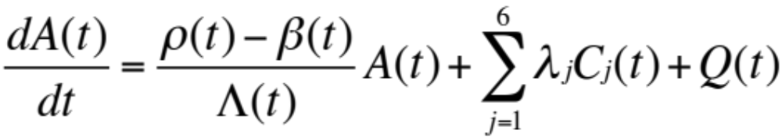

Overview of TDKENO
TDKENO solves the 3D time dependent transport equation with the explicit representation of delayed neutrons with the Improved Quasi Static (IQS) Method.
Relies on factorizing the total angular flux:
Amplitude – contains the time dependence
Shape – neutron flux info. Modified form of stationary transport equation, fixed source problem.

Slide 4
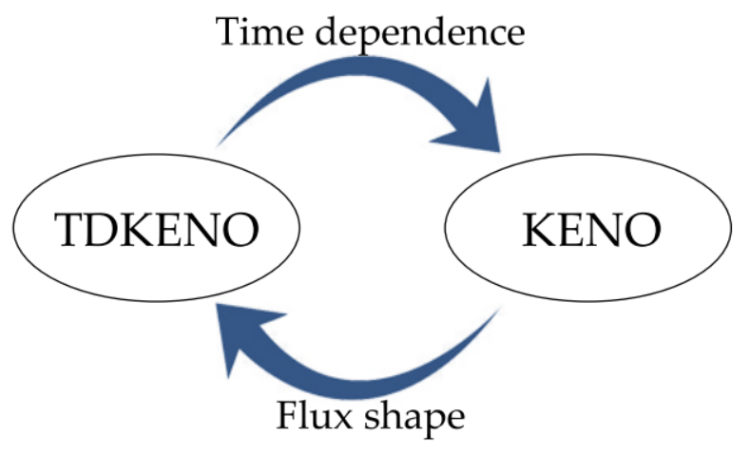
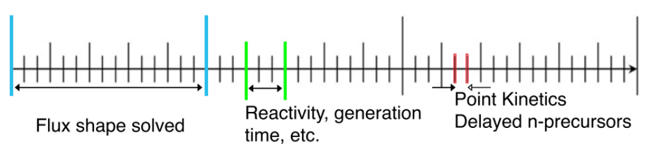
TDKENO Overview
Hybrid solver, Amplitude solved deterministically.
Shape solved via Monte Carlo with KENO (V.a or VI).
Solved iteratively on several time scales.

Slide 5
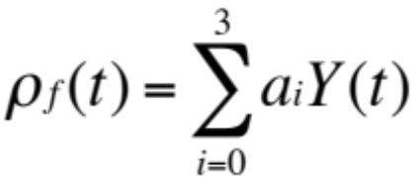
Current Status of TDKENO
Feedback mechanisms specific to a problem
For TREAT, relies on a reactivity feedback method from empirical data.
Where a_{i} is the empirical coefficient and Y(t) is the yield @ time t
Results from M8CAL simulations generally agree with experiment.
Does not calculate peak power compared to experiment.
Need to include Doppler broadening of the cross sections.

Slide 6
Methods for Incorporating Thermal Feedback
Internal – Build TDKENO under the MOOSE framework
Challenging as TDKENO is built in Fortran 90 and relies on KENO for part of the calculation.
KENO has competing runtime MPIlibraries
with MOOSE
External – Build TDKENO and MOOSE separately, instead pass around input/output files.
Quicker to implement, less robust, increased computational over head.
MOOSE
TDKENO
.out
TDKENO
MOOSE
.out

Slide 7
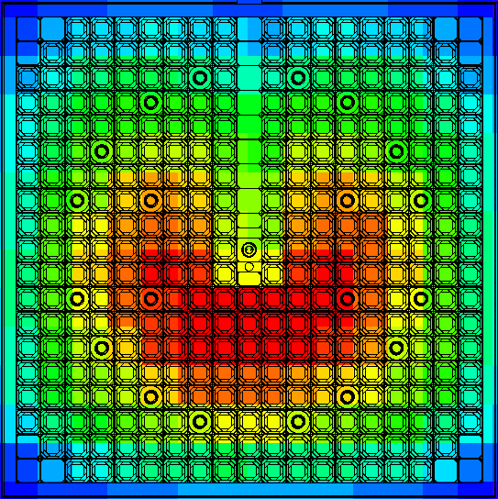
Initial Coupling Attempt with MOOSE
TDKENO can use KENOs ability to tally fluxes/fissions on a mesh.
This Cartesian mesh is defined by the user.
2D slice of TREAT model with the flux mesh overlaid. (Model is 3D)
Goal: Export into MOOSE
Discretize based on fuel elements because cross sections will be updated based on these elements
  Each unit has unique mixture.
Result: Difficult to do in practice.

Slide 8
Initial Coupling Attempt with MOOSE
Converting KENO mesh into something MOOSE can read is hard
Difficult because KENO outputs mesh in a proprietary format. (.3dmap)
Can convert to legacy VTK ASCII rectilinear mesh.
However, MOOSE only reads VTK unstructured XML format.
Tried several methods for conversion.
3dMap → VTK(rectilinear) → VTK XML → MOOSE ☒
3dMap → VTK(rectilinear) → VTK XML → .XYZ Mesh → MOOSE **
3dMap → VTK(rectilinear) → Exodus II → MOOSE ☒
3dMap → Exodus II → MOOSE ☒
**Worked, but lost variable information.

Slide 9
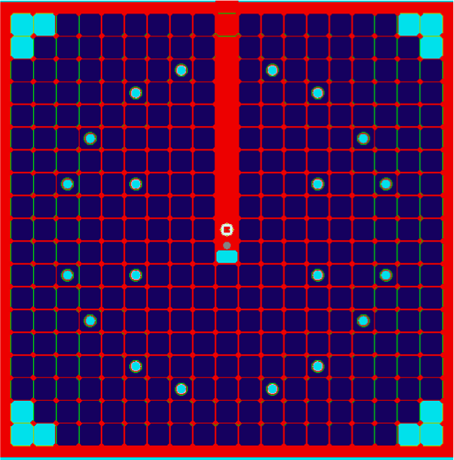
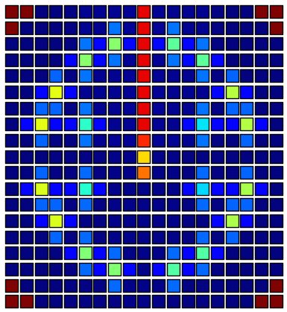
Coupling to MOOSE
Instead of importing the KENO mesh, create a pseudo mesh, a corresponding mesh with MOOSE, and map values to the MOOSE mesh.
Since the TREAT model has a unique fuel element per unit and tallies the fission density for those units, making this process easier.
KENO MODEL (2D) slice
Pseudo 2D mesh

Slide 10

Mapping to MOOSE Mesh
Nodal points correspond to the location of fuel element created in KENO
Pseudo 2D mesh
MOOSE Mesh
Only getting 2D feedback with this approach, hope to generalize to 3D.

Slide 11


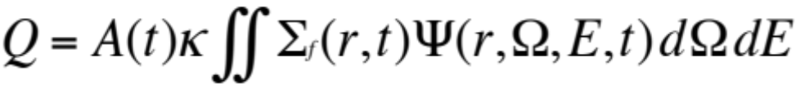
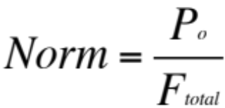
Mapping to MOOSE Mesh
Solving the steady state heat conduction equation in MOOSE.
Fission density converted to power density. Power density and thermal conductivity mapped to quadrature points on the MOOSE mesh.
Used simple energy/fission value of 192 MeV/fission
Normalized to initial power
Additional challenge: get amplitude information from TDKENO.

Slide 12
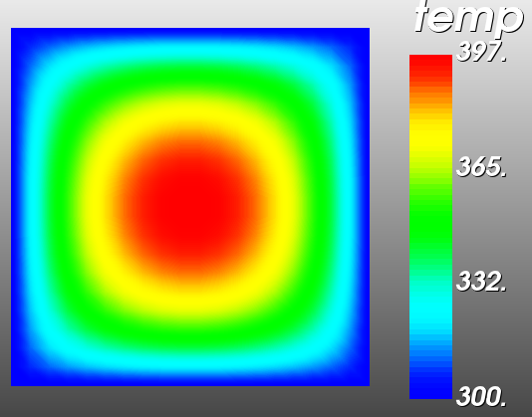
Initial Results
Coupling incomplete, still assessing the MOOSE solves.
@ t = 0.13s
Normalized to initial power
Thermal conductivity from
TREAT data, same
throughout
Dirichlet B.C. @ T=300K
Initial Conditions: T=300K
Solve takes ~0.2s
*Temp in Kelvin

Slide 13
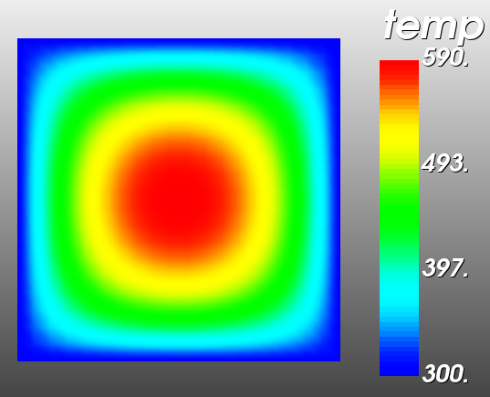
Initial Results
Coupling incomplete, still assessing the MOOSE solves.
@ t = 1.0s
Over calculating
Dirichlet B.C. @ T=300K
Initial Conditions: T=300K
Need to couple on the
scale of point kinetics.

Slide 14
Approach to Coupling Going Forward
External coupling may be too computationally intensive
Current approach is somewhat problem specific.
Require methods to handle a variety of problems, to simulate feedback under transient conditions properly.
4 possibilities were investigated for future research.
  Build TDKENO as a MOOSE App Explicitly
  Modify TDKENO to use a different Monte Carlo Solver
  Introduce Functional Expansion Tallies(FETs) in KENO
  Solve the heat conduction equation via Monte Carlo

Slide 15
Build TDKENO as MOOSE Application
Goal: Build TDKENO under MOOSE to simplify coupling.
Requires generalized to mapping between CSG and mesh.
Disadvantages
  Difficult to come up with CSG → Mesh scheme
  Challenging to build TDKENO under the MOOSE framework.
  Building KENO under MOOSE is not ideal (though not 100% necessary).
Advantages
  Can introduce additional physics
  Code comparisons would be more meaningful.
  Access to all of MOOSEs features.

Slide 16
Use a Different Monte Carlo Solver in TDKENO
Since TDKENO only uses KENO externally to get the shape function, presumably another code could perform the same purpose.
Disadvantages
  May need to modify governing equations slightly, especially if continuous energy mode is desired.
  Require significant rewriting of TDKENO.
  KENO is well established and mature.
Advantages
  Adopting a code with a multi-physics framework embedded would greatly simplify coupling.
  More “modern” codes should be easier to modify for this purpose.
  These codes have improved methods for cross sections updating (Serpent, OpenMC).

Slide 17
Introduce Functional Expansion Tallies
Modifying KENO to incorporate FETs.
Disadvantages
  KENO source code is difficult to modify.
  Continues reliance on KENO.
  Somewhat limited to specific fuel geometries.
  Polygon shapes like TREAT fuel elements untested.
Advantages
  Other work has been done in MOOSE that reads in the FET coefficients.
  Minimal data is passed between the two.
  TDKENO source code would not be significantly modified.
  Useful analysis tool outside of transient problems.

Slide 18
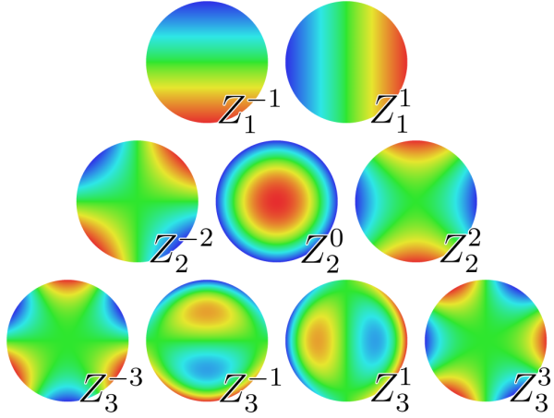
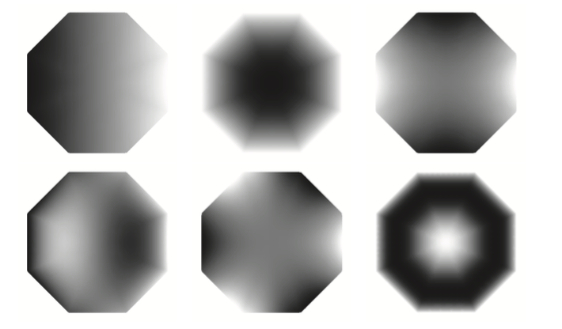
FETs for TREAT Problem
TREAT fuel elements are not circular, thus the traditional Zernike polynomials used to capture the radial distribution may not suffice.
Recent work in optical physics has provided a generalized method for creating valid Zernike Polynomials on polygon shapes.

Slide 19
Solve the Heat Equation via Monte Carlo
The heat conduction equation is a diffusion type equation with the same structure as that used in diffusion based neutron transport.
Work has been done showing this equation can be solved via Monte Carlo with complex geometries.
Disadvantages
  Increased computational time compared to deterministic methods.
  Requires significant programming from the ground up.
  No connection to a generalized solver like MOOSE. Limits physics.
Advantages
  No discretization of the geometry
  Handle a variety of problems, (ex. KAIST has been looking at this method for TRISO fuel modeling)
  Can incorporate complex material properties.

Slide 20
Heat Equation via Monte Carlo Cont.
This has not been attempted in transient analysis, excellent opportunity for new research to be done.
Investigate solving Monte Carlo problems on new architecture (GPUs)
Theoretical background on this has been investigated in the late 1970s.
At the time the computational overhead was too great.

Slide 21
Conclusions
A first attempt at coupling TDKENO/MOOSE is under way.
Still looking issues with the current implementation.
Problem not as trivial as once thought.
After ~1 month of work we have a handle on the best approaches.
Lots of interesting opportunities going forward, all of which will require significant development.

Slide 22
Acknowledgements
Funding from the INL to conduct this research.
Support from Leslie and Javi over the summer
MOOSE team for answering many questions on the user group.
Sedat Goluoglu, Mark DeHart for making this visit possible.

Slide 23
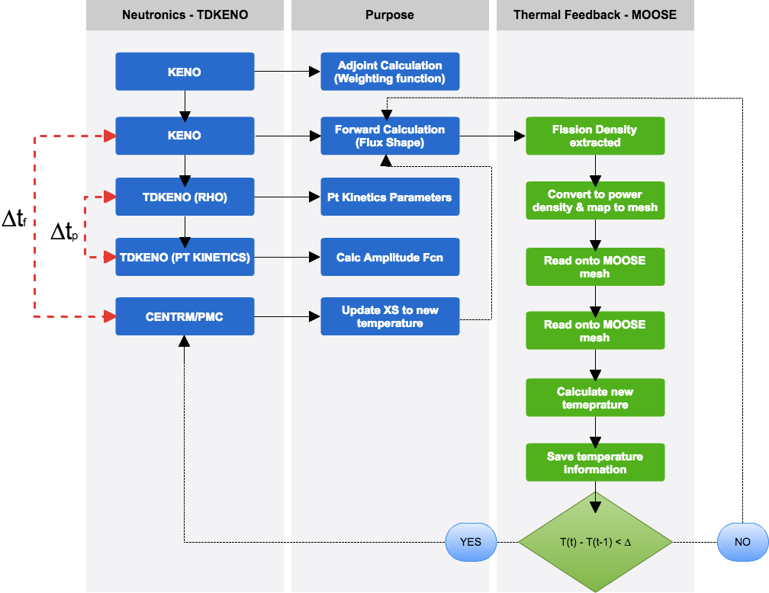

Slide 24
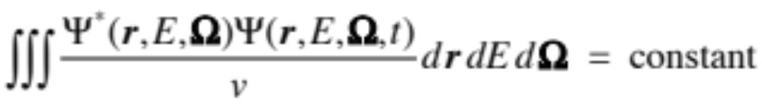
Normalization

Slide 25
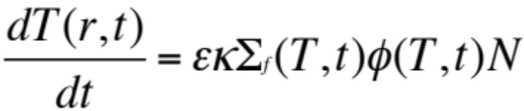
Incorporating Adiabatic Heat-up Model
In an attempt to get something working by the end of the summer for the TREAT problem, and adiabatic heat-up model is looked at.
Fast transients this appears to be a good approximation.
Heat deposited locally within fuel elements.
Calculation can be done within TDKENO only.
No need to couple with MOOSE.
Challenging due to iterative scheme on different time scales.
Still in progress.
Hope is to update at scale of flux shapes and calculate a new multi-group cross sections.

Slide 26
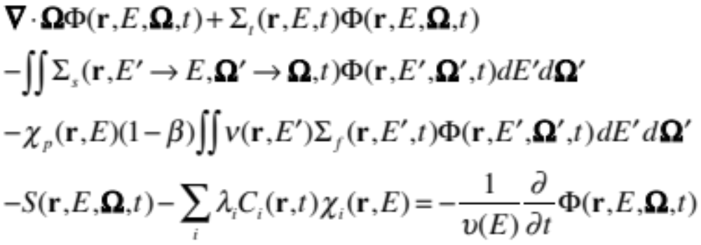
Shape Equation

Slide 27
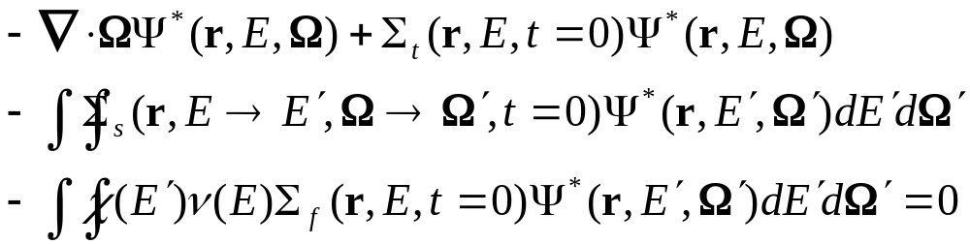
Adjoint Transport Equation

Slide 28
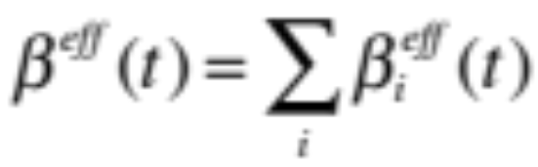
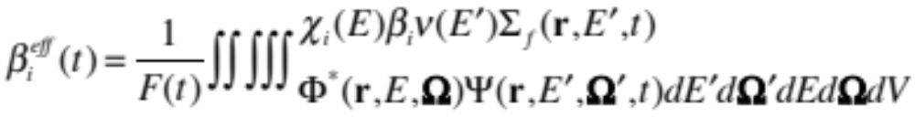
Amplitude Equation

Slide 29
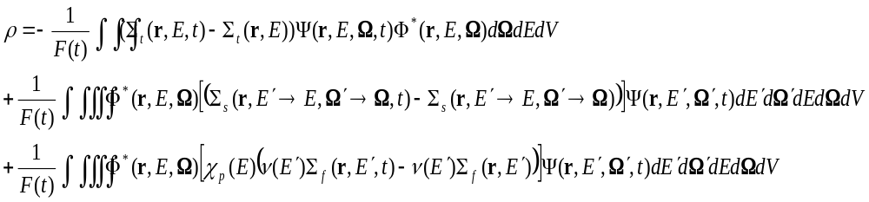
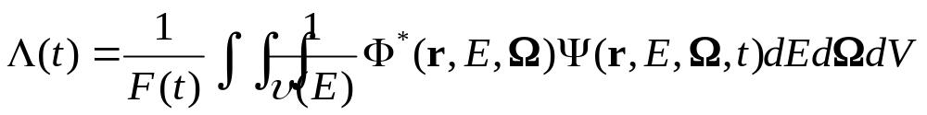
Reactivity and Generation Time

Slide 30
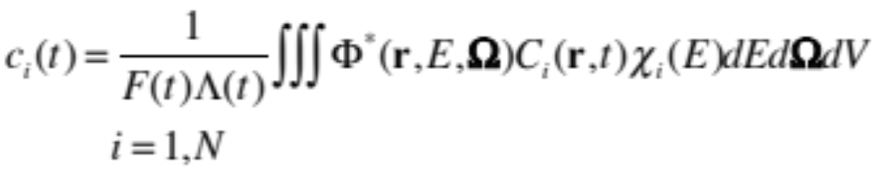
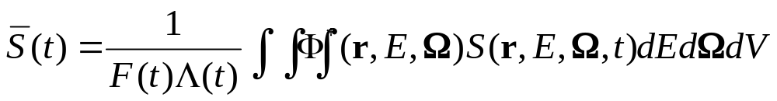
Precursor and Fixed Source

